Slide 1
iBeacons
CocoaHeads
Bryan O’Malley
Fingerpaint

Slide 2
What are iBeacons?
“iBeacon is the name for Apple’s technology standard, which allows Mobile Apps (running on both iOS and Android devices) to listen for signals from beacons in the physical world and react accordingly.” – ibeacon.com

Slide 3
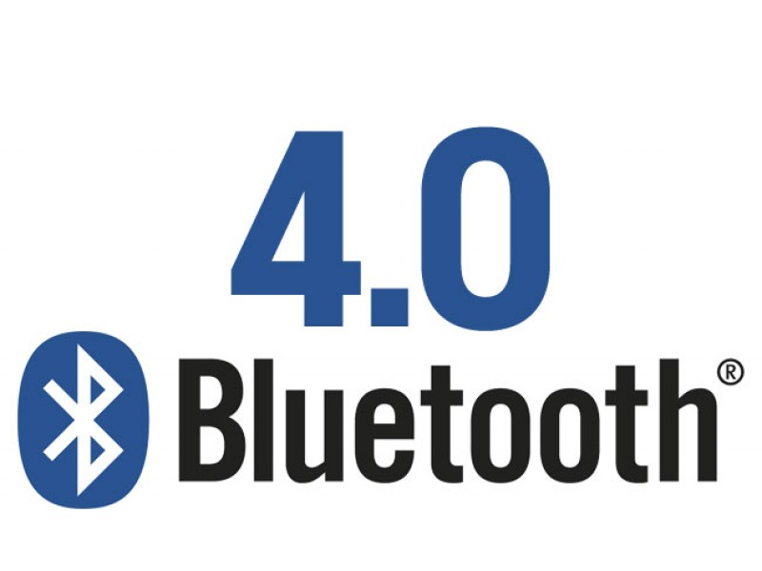
What are iBeacons?

Slide 4

What do iBeacons look like?

Slide 5
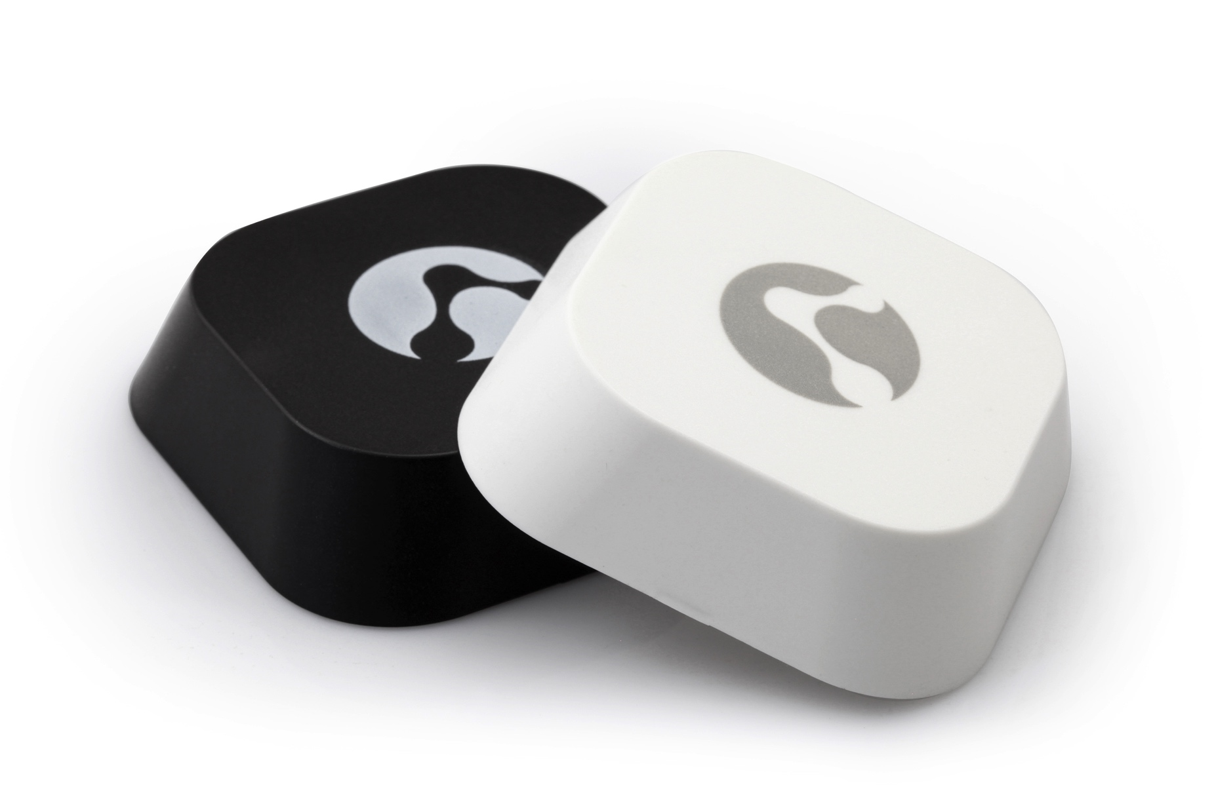
What do iBeacons look like?

Slide 6
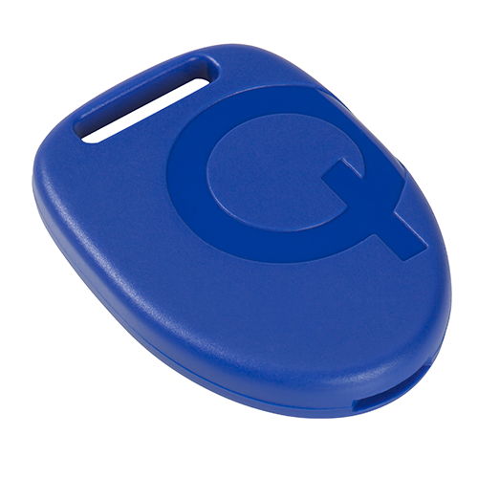
What do iBeacons look like?

Slide 7
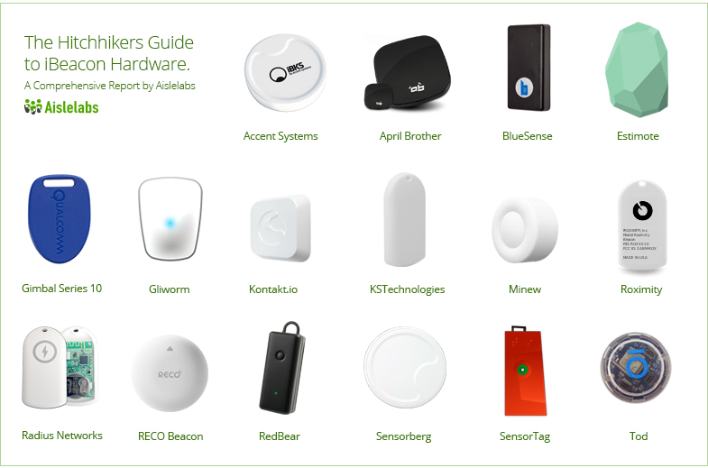
What do iBeacons look like?

Slide 8
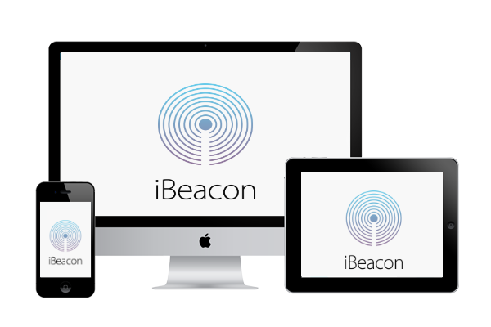
What do iBeacons look like?

Slide 9





Who is using iBeacons?

Slide 10



Who is using iBeacons?

Slide 11

Who is using iBeacons?

Slide 12
How do iBeacons work?
iBeacon
Immediate
Near
Far

Slide 13
How do iBeacons work?
iBeacons transmit 3 pieces of information:
UUID (1986dc82-b1b6-4029-b4e3-64fc6c876feb)
Major (6)
Minor (88)

Slide 14
iBeacon receiver concepts
Create a Location Manager
Create a Beacon Region
Start monitoring for events within the Region
React to iBeacons within the Region

Slide 15
iBeacon transmitter concepts
Create a Beacon Region
Create a Peripheral Manager
Start advertising your Beacon

Slide 16
iBeacon code gotchas
Add the CoreLocation.framework
Add the Location Updates and Uses Bluetooth LE accessories Capabilities
Request authorization

Slide 17
Resources
https://developer.apple.com/ibeacon/
http://blog.lighthousebeacon.io/interesting-ibeacon-applications-around-world/

Slide 18


Wrap it up!
Demo Source Code:
https://github.com/bomalley/iBeaconsDemo
@bryanomalley bryanomalley.com
Cohabit Sudoku
Colortoons

